Slide 1
Smart Parking in Toronto
Anxin Zhao
Bharadwaj Janarthanan
Seung Eun Yi

Slide 2
Agenda
Motivation
Primary Questions
Secondary Research Questions
Visualization Sample
Project Timeline
Key Challenges

Slide 3
Motivation
30% of the traffic in large cities downtown areas is caused by cars searching for parking.*
It takes around 7.8 minutes to find a free parking spot in average.*
Higher amount of time spent on searching for parking leads to:
traffic congestion
additional consumption of fuel
safety issues & higher stress
How could we optimize parking time?
*https://www-03.ibm.com/press/us/en/pressrelease/35515.wss

Slide 4
Primary Research Questions
I. Individual vehicles : How do we optimize parking time?
II. General organization: Where can we place new parking facilities?

Slide 5
I. Individual vehicles : How do we optimize parking time?
How do we identify free parking spots ?
Compare the total available slots to the total number of vehicles searching for parking at different points of time
Plot this information to indicate to the user potential zones with free parking areas
How do we decide which vehicle to place at each free parking spot ?
Study congestion close to the free parking spot
Design a score for the vehicle getting the parking spot
Use a heat map visualisation to observe congestion close to free parking spots
How to provide an optimal route for vehicles to the parking spot ?
Use Google Maps API to show routes to closest free parking spots

Slide 6
II. General Organization: Where can we place new parking facilities
Which are the locations the vehicles spend most time in before finding a parking spot?
Compare avg. parking time and number of parking issues across each geohash location
How's vehicle movement at different neighborhoods?
A plot of # of vehicles circling through different geohashes before parking at a geohash
Is there a consistently growing number of vehicles circling around for parking at a neighborhood over a period of time?
A trend study of parking traffic across neighborhoods. ( Define a park time index metric to look at trend)

Slide 7
II. General Organization: Where can we place new parking facilities
Which are the neighborhoods in close proximity to the one with high traffic,with potential for more parking facilities?
Define a distance measure, based on distance, congestion levels (avg. time to park), traffic levels (avg. time to drive through), usage of current slots in the zone and pick top 5 neighborhoods
What kind of vehicles look for parking at a neighborhood?
A plot by type of vehicles and type of parking facilities available in neighborhood
Modelling:
Predict parking time index based on congestion, # of available parking facilities
Determine optimal # of parking facilities required to reduce park time index by x%

Slide 8
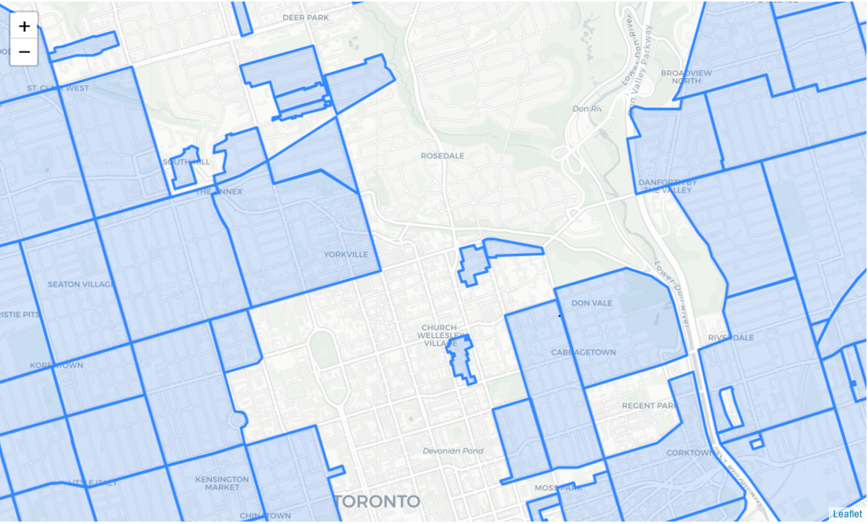
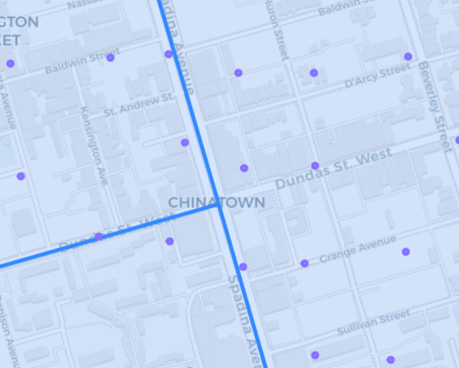
Visualization Sample

Slide 9
Project Timeline
WE ARE HERE
Description
Research and Data Survey
Project Proposal
Data Collection
Data Processing
Exploratory Data Analysis
Modelling
W01 | W02 | W03 | W04 | W05 | W06 | W07 | W08 | W09 | W10 | W11

Slide 10
Project Timeline
Description
Draft Report Review
Model Validation and Revision
Final Project Report and Presentation Draft
Final Presentation
W01 | W02 | W03 | W04 | W05 | W06 | W07 | W08 | W09 | W10 | W11

Slide 11
Key Challenges
Data at vehicle level is not readily available on GeoTab
Converting address to coordinate and geohash
Use geohash as primary key - not precise as coordinate
Incomplete / Conflicting / Complex information about different parking locations and available time slots
Different file formats and time differences in data collected

Slide 12
Questions?

